Slide 1
Sprint 1 overview
Project Persistent - Parantion

Slide 2
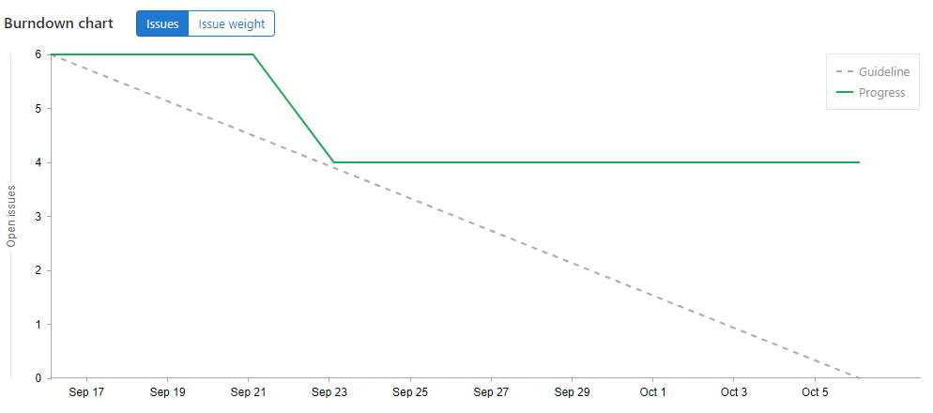
Burndown chart

Slide 3
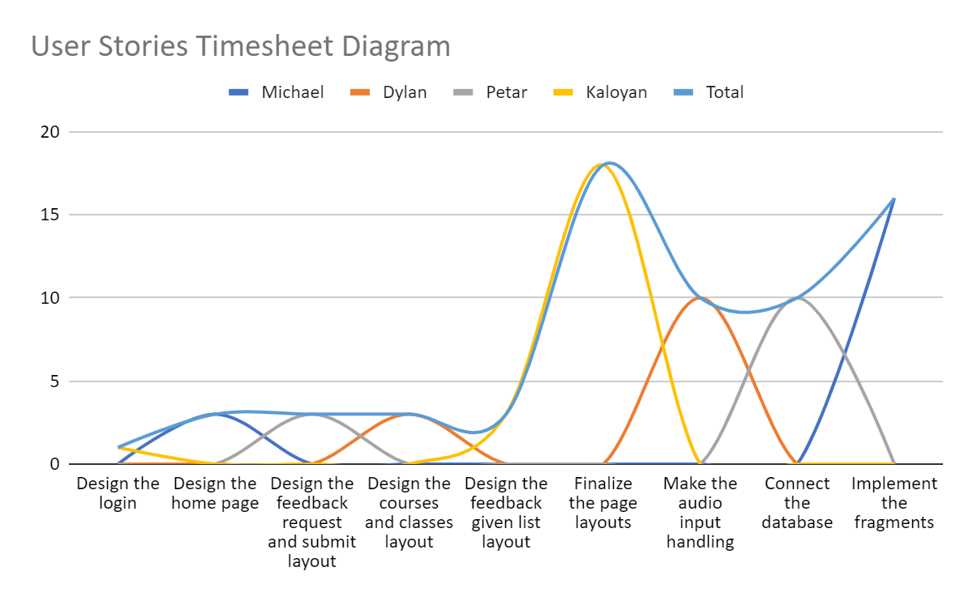

Slide 4
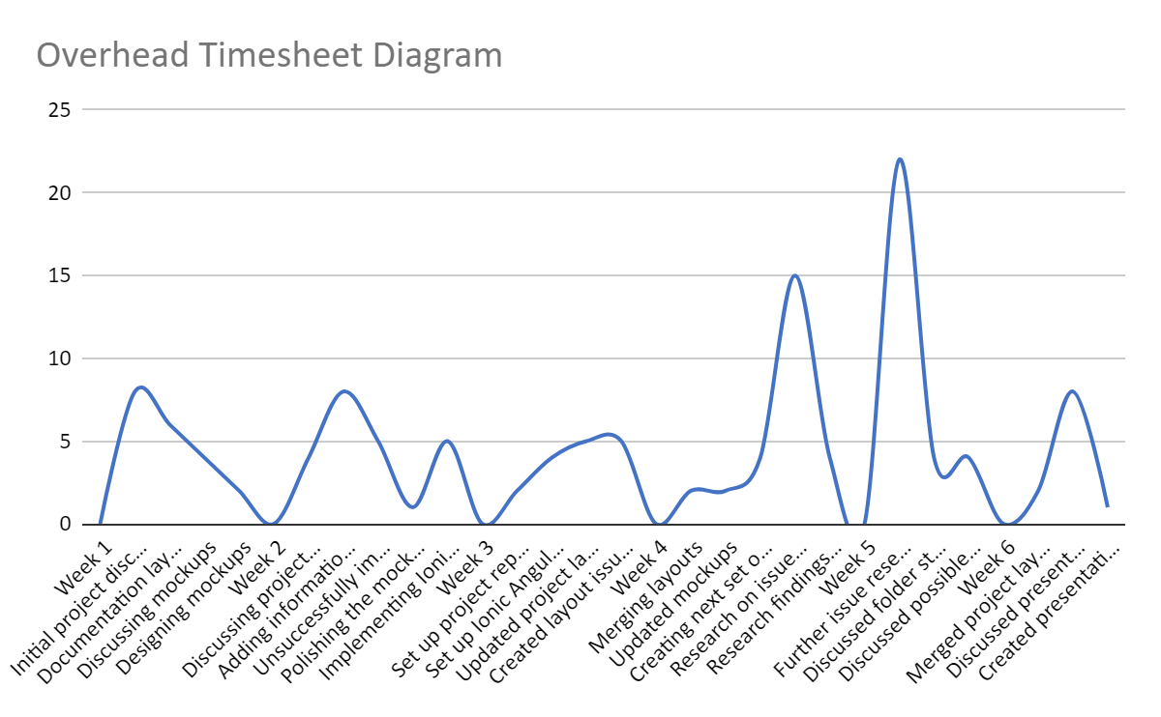

Slide 5
Demo

